Slide 1
IoT BASED TANK OIL LEVEL MONITORING SYSTEM
Group J
Felix Thokozan: 218014375
GATERA Antoine: 218015825

Slide 2
COMPONENTS
Hardware components :
Ultrasonic Sensor
Jumper wires
Arduino Uno Board
Software components:
Arduino IDE
Blink Mobile App

Slide 3
System design
Ultrasonic sensor to monitor the level of oil in the tank
The monitoring is done remotely
Based on level status, the system will allow the owner to know when refilling
The status of the tank is viewed on owner’s web platform

Slide 4
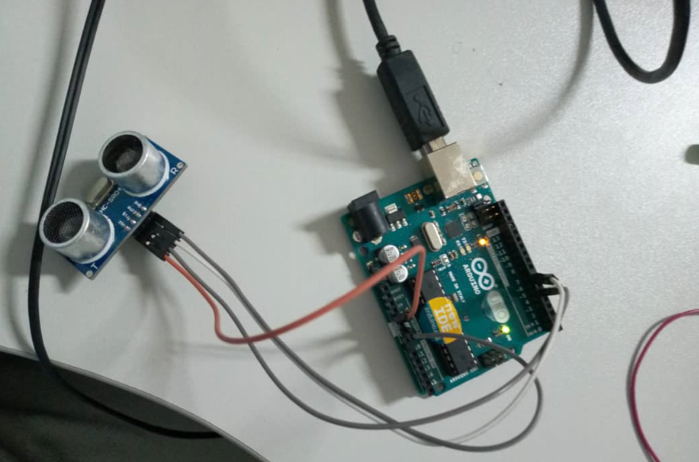
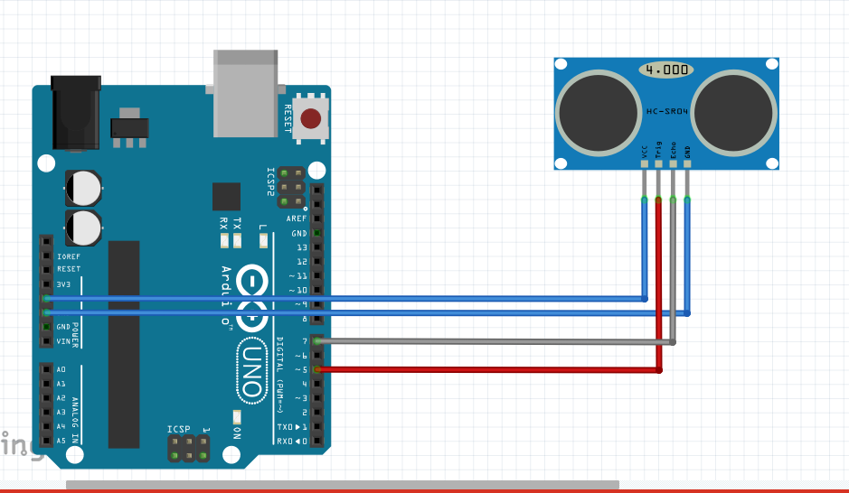
Design(Cont.)

Slide 5
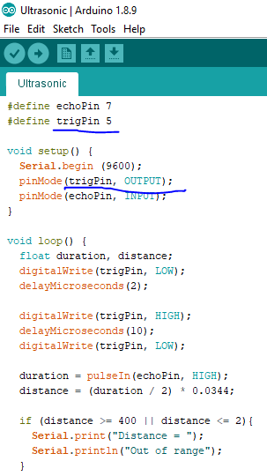
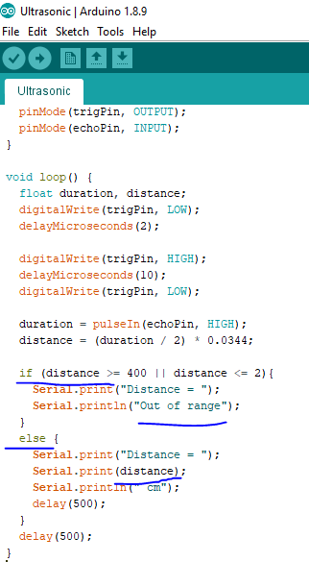
Before getting connected through portal

Slide 6
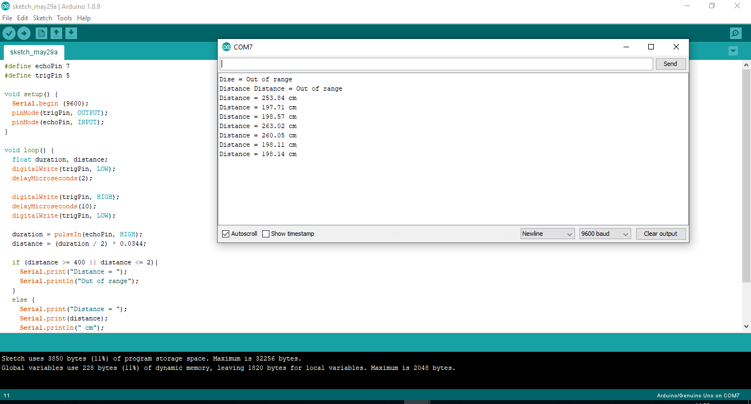
OUTPUT

Slide 7
